Slide 1
INTERPROCESSOR ARBITRATION
(Computer Architecture & its Organization
Unit V)
Mr. Muthiah M.A
Assistant Professor
Department of ECE
Sathyabama Institute of Science and Technology

Slide 2
Contents
System Bus
Synchronous Bus
Asynchronous Bus
Serial Arbitration Procedure
Parallel Arbitration Logic
Dynamic Arbitration Algorithms

Slide 3
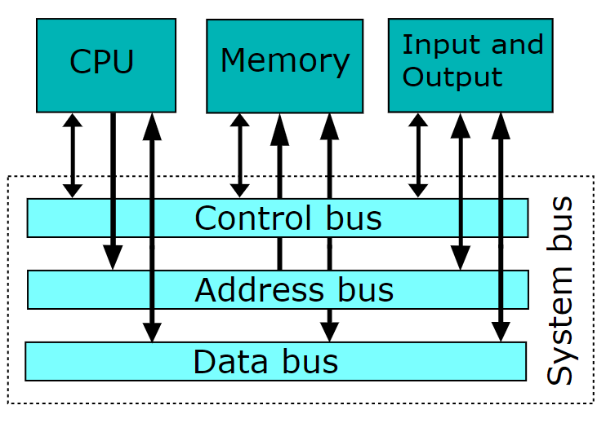
System Bus
A system bus is a single computer bus that connects the major components of a computer system, combining the functions of a data bus to carry information, an address bus to determine where it should be sent, and a control bus to determine its operation.
A memory bus consists of lines for transferring data, address, and read/write information. An I/O bus is used to transfer information to and from input and output devices.

Slide 4
System Bus (cntd.)
It consists of approximately 100 signal lines and they are divided into three groups:
  Data Bus
  Address Bus
  Control Bus
For example, the IEEE standard 796 multi-bus system has 16 data lines, 24 address lines(224 mega words), 26 control lines, and 20 power lines, for a total of 86 lines.
The address buffers are unidirectional from processor to memory. The data lines are bidirectional allowing the transfer of data in either direction.

Slide 5
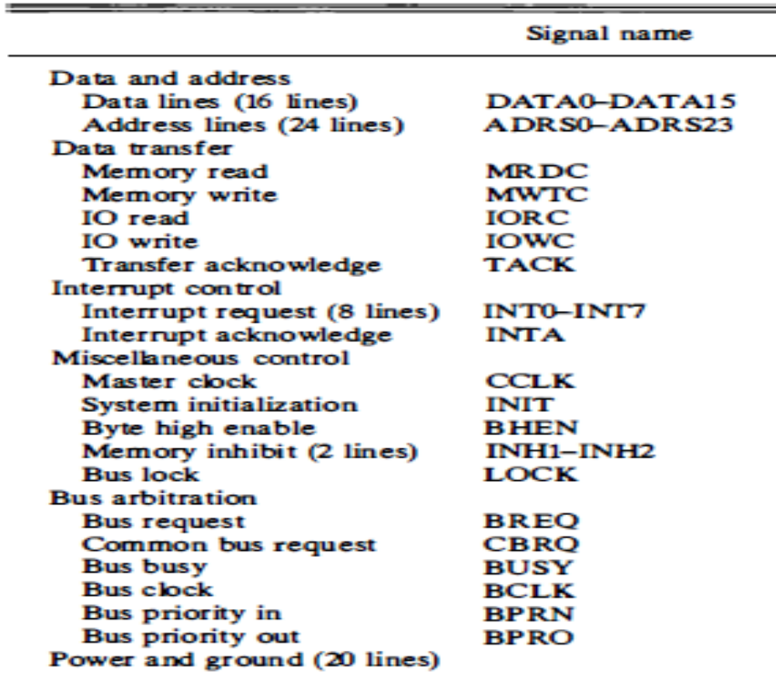
IEEE standard 796 multibus system

Slide 6
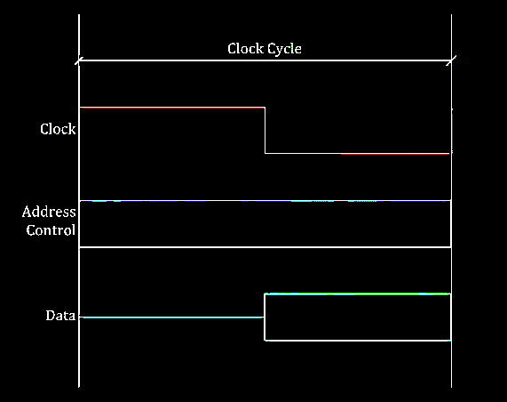
Synchronous BUS
In a synchronous bus, each data item is transferred during a time slice known in advance to both source and destination units.
Synchronization is achieved by driving both units from a common clock source. An alternative procedure is to have separate clocks of approximately the same frequency in each unit.
Synchronization signals are transmitted periodically in order to keep all clocks in the system in step with each other.

Slide 7
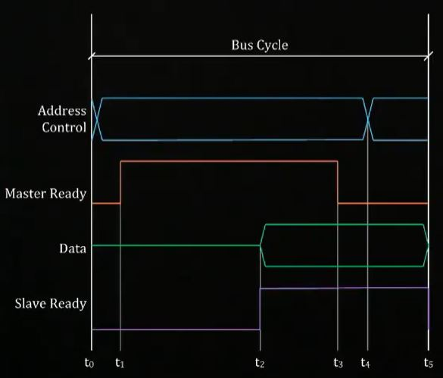
Asynchronous Bus
In an asynchronous bus, each data item being transferred is accompanied by handshaking control signals to indicate when the data are transferred from the source and received by the destination
Each data item is transferred by Handshake mechanism –
  Unit that transmits the data transmits a control signal that indicates the presence of data
  Unit that receiving the data responds with another control signal to acknowledge the receipt of the data
Strobe pulse - supplied by one of the units to indicate to the other unit when the data transfer has to occur

Slide 8
lnterprocessor Arbitration
Static arbitration
  Serial Arbitration
  Parallel Arbitration
Dynamic arbitration
  The Time Slice Algorithm
  Polling
  LRU
  FIFO
  Rotating Daisy Chain

Slide 9
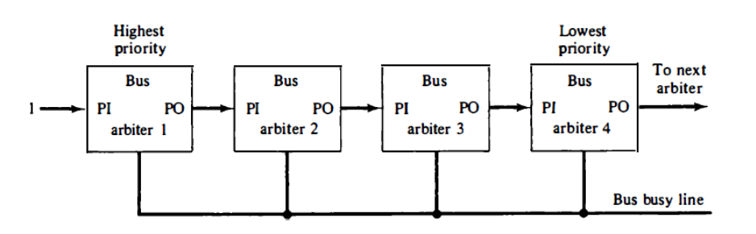
Serial Arbitration Procedure
The processors connected to the system bus are assigned priority according to their position along the priority control line
The device closest to the priority line is assigned the Highest priority
When multiple devices concurrently request the use of the bus, the device with the highest priority is granted access to it
It is assumed that each processor has its own bus arbiter logic with priority-in and priority-out lines

Slide 10
Serial Arbitration (Daisy Chain )
Highest Priority
Lowest Priority
Bus
Bus
Bus
Bus
0
1
1
To next arbiter
1
PI
PO
PI
PO
PI
PO
PI
PO
arbiter I
arbiter 2
arbiter 3
arbiter 4
Bus Busy Line=0 INACTIVE
Bus Busy Line=1 ACTIVE
The priority out (PO) of each arbiter is connected to the priority in (PI) of the next-lower-priority arbiter.
The PO output for a particular arbiter is equal to 1 if its PI input is equal to 1 and the processor associated with the arbiter logic is not requesting control of the bus.
If the processor requests control of the bus and the corresponding arbiter finds its PI input equal to 1, it sets its PO output to 0.
When an arbiter receives control of the bus (because its PI = 1 and PO = 0) it examines the busy line. If the line is inactive, it means that no other processor is using the bus. The arbiter activates the busy line and its processor takes control of the bus . However, if the arbiter finds the busy line active, it means that another processor is currently using the bus.

Slide 11
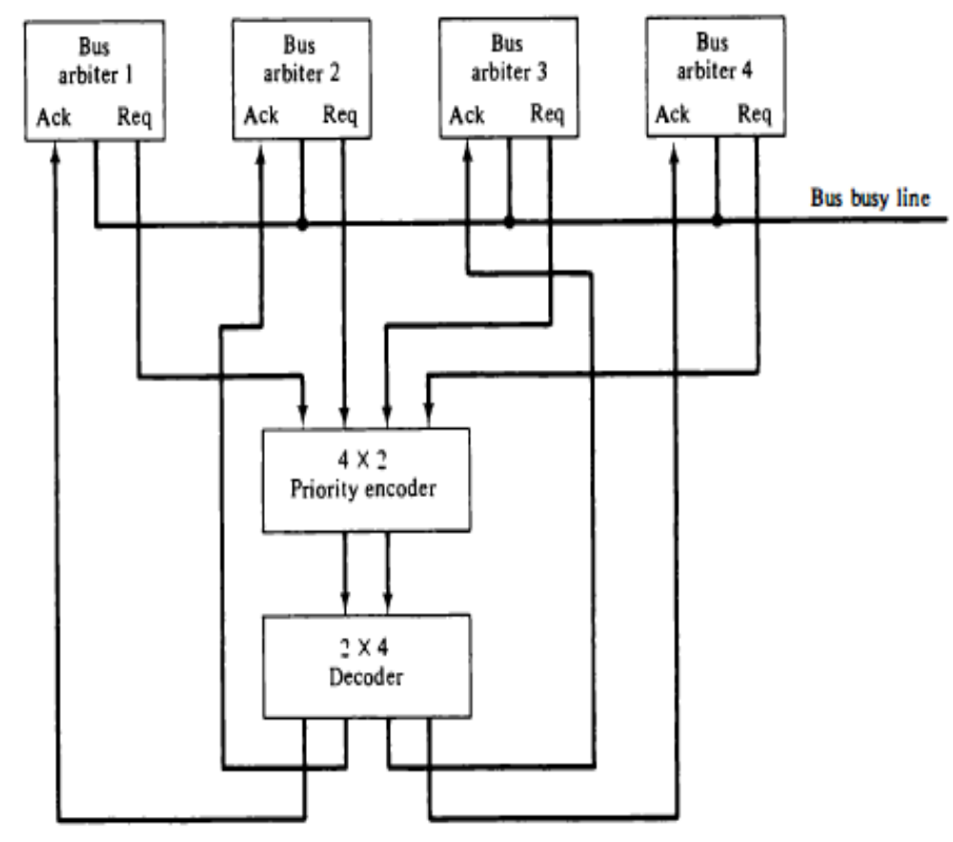
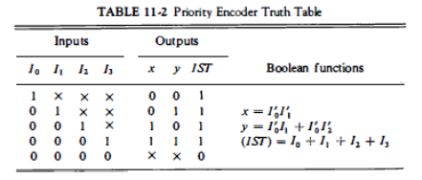
Parallel Arbitration Logic
The parallel bus arbitration technique uses an external priority encoder and a decoder
Request lines from four arbiters going into a 4 x 2 priority encoder.

Slide 12
Parallel Arbitration Logic (cntd.)
The output of the encoder generates a 2-bit code which represents the highest-priority unit among those requesting the bus.
The truth table of the priority encoder can be found in Table
The 2-bit code from the encoder output drives a 2 x 4 decoder which enables the proper acknowledge line to grant bus access to the highest-priority unit.

Slide 13
Dynamic Arbitration Algorithms
Dynamic priority algorithm gives the system the capability for changing the priority of the devices while the system is in operation.
  The Time Slice Algorithm
  Polling
  LRU
  FIFO
  Rotating Daisy Chain

Slide 14
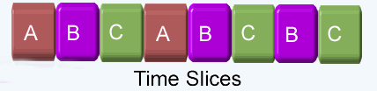
The Time Slice Algorithm
It allocates a fixed-length time slice of bus time that is offered sequentially to each processor, in round-robin fashion.
The service given to each system component with this scheme is independent of its location along the bus.
No preference is given to any particular device since each is allotted the same amount of time to communicate with the bus.

Slide 15
Polling
In a bus system that uses polling, the bus grant signal is replaced by a set of lines called poll lines which are connected to all units.
These lines are used by the bus controller to define an address for each device connected to the bus.
The bus controller sequences through the addresses in a prescribed manner.
When a processor that requires access recognizes its address, it activates the bus busy line and then accesses the bus.
After a number of bus cycles, the polling process continues by choosing a different processor.
The polling sequence is normally programmable, and as a result, the selection priority can be altered under program control.

Slide 16
Least Recently Used (LRU)
The Least Recently Used (LRU) algorithm gives the highest priority to the requesting device that has not used the bus for the longest interval.
The priorities are adjusted after a number of bus cycles according to the LRU algorithm.
With this procedure, no processor is favored over any other since the priorities are dynamically changed to give every device an opportunity to access the bus.

Slide 17
Rotating Daisy-chain
The rotating daisy-chain procedure is a dynamic extension of the daisy-chain algorithm. In this scheme there is no central bus controller, and the priority line is connected from the priority-out of the last device back to the priority-in of the first device in a closed loop.
This is similar to the Daisy Chain where the PO output of arbiter 4 is connected to the PI input of arbiter 1.
Whichever device has access to the bus serves as a bus controller for the following arbitration.
Each arbiter priority for a given bus cycle is determined by its position along the bus priority line from the arbiter whose processor is currently controlling the bus.
Once an arbiter releases the bus, it has the lowest priority

Slide 18
Rotating Daisy-chain (cntd.)
Highest Priority
Lowest Priority
Bus
Bus
Bus
Bus
0
1
1
To next arbiter
1
PI
PO
PI
PO
PI
PO
PI
PO
arbiter I
arbiter 2
arbiter 3
arbiter 4
Bus Busy Line=0 INACTIVE
Bus Busy Line=1 ACTIVE

Slide 19
THANK YOU

